Slide 1
Chapter 9
Code Generation

Slide 2
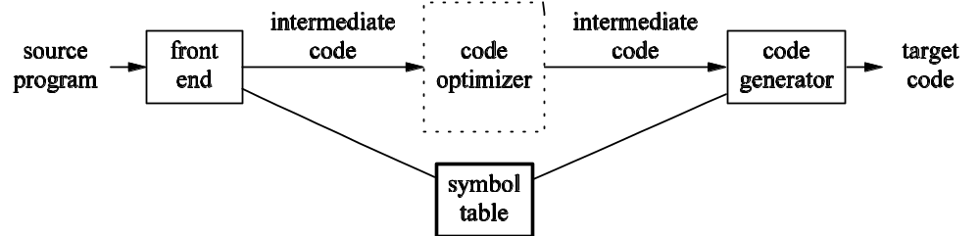
Code Generation and Phases

Slide 3
9.1 Code Generator
Severe requirements imposed
  Output must be correct and high quality
  Generator should run efficiently
Generating optimal code is undecidable
  Must rely on heuristic
  Choice of heuristic very important
Details are dependent on target language and operating system
Certain generic issues are inherent in the design of basically all code generators

Slide 4
Input to Code Generator
The input to the code generator consists of:
  Intermediate code produced by the front end (and perhaps optimizer)
    Remember that intermediate code can come in many forms
    We are concentrating on three-address code but several techniques apply to other possibilities as well
  Information in the symbol table (used to determine run-time addresses of data objects)
The code generator typically assumes that:
  The input is free of errors
  Type checking has taken place and necessary type-conversion operators have already been inserted

Slide 5
Output of Code Generator
The target program is the output of the code generator
Can take a variety of forms
  absolute machine language
  relocatable machine language
    Can compile subprograms separately
    Added expense of linking and loading
  assembly language
    Makes task of code generation simpler
    Added cost of assembly phase

Slide 6
Memory Management
Compiler must map names in source code to addresses of data objects at run-time
  Done cooperatively by front-end and code generator
  Generator uses information in symbol table
If machine code is being generated:
  Labels in three-address statements need to be converted to addresses of instructions
  Process is analogous to backpatching

Slide 7
Instruction Selection (1)
Obviously this depends on the nature of the instruction set
If efficiency is not a concern, instruction selection is straight-forward
  For each type of three-address statement, there is a code skeleton outlines target code
  Example, x := y + z, where x, y, and z are statically located, can be translated as:
    MOV y, R0 /* load y into register r0 */
    ADD z, R0 /* add z to r0 */
    MOV R0, x /* store R0 into x */

Slide 8
Instruction Selection (2)
Often, the straight-forward technique produces poor code:
A naïve translation may lead to correct but unacceptably inefficient target code:
MOV b, R0
ADD c, R0
MOV r0, a
MOV a, R0
ADD e, R0
MOV R0, d
a := b + c
d := a + e
MOV a, R0
ADD #1, R0
MOV r0, a
a := a + 1

Slide 9
Register Allocation
Instructions are usually faster if operands are in registers instead of memory
Efficient utilization of registers is important in generating good code
Register allocation selects the set of variables that will reside in registers
A register assignment phase picks the specific register in which a variable resides
Finding an optimal assignment of registers to variables is difficult
  The problem is NP-complete
  Certain machines require register-pairs for certain operators and results

Slide 10
9.2 The Target Machine
Familiarity with instruction set of target is a prerequisite for good code generation
Textbook uses a representative assembly language of a representative target computer
  Byte-addressable machine with four bytes to a word
  Machine uses n general-purpose registers R0, R1, … Rn
  Two-address instructions of form: op source, destination
  The op-codes include MOV, ADD, and SUB (among others)
  Certain bit patterns in source and destination fields specify that words following instruction contain operands and/or addresses
Techniques discussed are more general and have been used on several classes of machines

Slide 11
Address Modes of Sample Machine
MODE | FORM | ADDRESS | ADDED COST
absolute | M | M | 1
register | R | R | 0
indexed | c(R) | c + contents(R) | 1
indirect register | *R | contents(r) | 0
indirect indexed | *c(R) | contents(c + contents(R)) | 1
MODE | FORM | CONSTANT | ADDED COST
literal | #c | c | 1

Slide 12
Instruction Costs
Cost of instruction for sample computer is:
  Equal to one plus the costs associated with the source and destination address modes
  Corresponds to the length (in words) of the instruction
  Address modes involving registers have cost zero
  Those with memory location or literal have cost one since operands have to be stored with instruction
Time taken to fetch instruction often exceeds time spent executing instruction

Slide 13
Example: a := b + c
The following solution has cost 6:
  MOV b, R0
  ADD c, RO
  MOV R0, a
The following solution also has cost 6:
  MOV b, a
  ADD c, a
If R0, R1, and R2 contain the addresses of a, b, and c, respectively, the cost can be reduced to 2:
  MOV *R1, *R0
  ADD *R2, *R0
If R1 and R2 contain the values of b and c, respectively, and b is not needed again, the cost can be reduced to 3:
  ADD R2, R1
  MOV R1, a

Slide 14
9.3 Activation Records
Activation records store information needed during the execution of a procedure
Two possible storage-allocation strategies for activation records are:
  static allocation
  stack allocation
An activation record has fields which hold:
  result and parameters
  machine-status information
  local data and temporaries
Size and layout of activation records are communicated to code generator via information in the symbol table

Slide 15
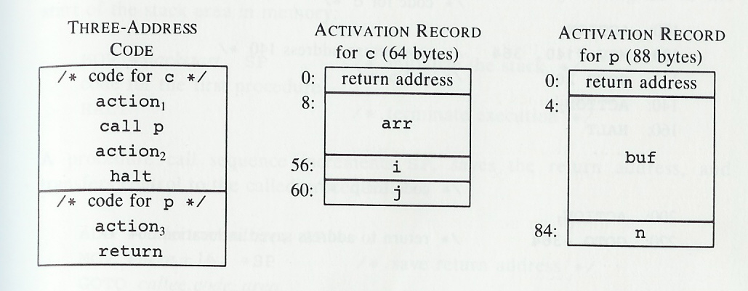
Sample Activation Records
Assume that run-time memory has areas for code, static data, and optionally a stack
Heap is not being used in these examples

Slide 16
Static Allocation
A call statement in the intermediate code is implemented by two target-machine instructions:
  MOV #here+20, callee.static_area
  GOTO callee.code_area
The MOV instruction saves the return address
The GOTO statement transfers control to the target code of the called procedure
A return statement in the intermediate code is implemented by one target-machine instruction:
  GOTO *callee.static_area

Slide 17
Sample Code
/* code for c */
100: action1
120: MOV #140, 364 /* save return address 140 */
132: GOTO 200 /* call p */
140: action2
160: HALT
…
/* code for p */
200: action3
220: GOTO *364
…
/* 300-363: activation record for c */
300: /* return address */
304: /* local data for c */
…
/* 364–451: activation record for p */
364: /* return address */
368: /* local data for p */

Slide 18
Stack Allocation (1)
Stack allocation uses relative addresses for storage in activation records
  Address can be offset from any known position in activation record
  Book uses positive offset from SP, a pointer to beginning of activation record at top of stack
The position of an activation record is not known until run-time
  This position is usually stored in a register
  The indexed address mode is convenient

Slide 19
Stack Allocation (2)
The code for the first procedure initializes the stack:
  MOV #stackstart, SP
  …code for the first procedure…
  HALT
A procedure call increments SP, saves the return address, and transfers control:
  ADD #caller.recordsize, SP
  MOV #here+16, *SP
  GOTO callee.code_area
A return sequence has two parts:
  First control is transferred to the return address
  GOTO *0(SP)
  Next, in the caller, SP is restored to its previous value
  SUB #caller.recordsize, SP

Slide 20
9.4 Basic Blocks
A basic block is a sequence of statements such that:
  Flow of control enters at start
  Flow of control leaves at end
  No possibility of halting or branching except at end
A name is "live" at a given point if its value will be used again in the program
Each basic block has a first statement known as the "leader" of the basic block

Slide 21
Partitioning Code into Basic Blocks
First algorithm must determine all leaders:
  The first statement is a leader
  Any statement that is the target of a conditional or unconditional goto is a leader
  Any statement immediately following a goto or unconditional goto is a leader
A basic block:
  Starts with a leader
  Includes all statements up to but not including the next leader

Slide 22
Basic Block Example
(1) prod := 0
(2) i := 1
(3) t1 := 4 * i
(4) t2 := a[t1]
(5) t3 := 4 * I
(6) t4 := b[t3]
(7) t5 := t2 * t4
(8) t6 := prod + t5
(9) prod := t6
(10) t7 := i + 1
(11) i := t7
(12) if i <= 20 goto 3
(13) …
begin
prod := 0;
i := 1;
do
begin
prod := prod + a[i] * b[i]
end
while i <= 20
end

Slide 23
Transformations on Basic Blocks
A basic block computes a set of expressions
  The expressions are the values of names that are live on exit from the block
  Two basic blocks are equivalent if they compute the same set of expressions
Certain transformations can be applied without changing the computed expressions of a block
  An optimizer uses such transformations to improve running time or space requirements of a program
  Two important classes of local transformations:
    structure-preserving transformations
    algebraic transformations

Slide 24
Example Transformations (1)
Algebraic Transformations:
  Statements such as x := x + 0 or x := x * 1 can be safely removed
  Statement x := y ^ 2 can be safely changed to x := y * y
Common subexpression elimination:
Dead-code elimination
  Suppose the statement x := y + z appears in a basic block and x is dead (i.e. never used again)
  This statement can be safely removed from the code
a := b + c
b := a – d
c := b + c
d := a - d
a := b + c
b := a – d
c := b + c
d := b

Slide 25
Example Transformations (2)
Renaming of Temporary variables
  Suppose the statement t := b + c appears in a basic block and t is a temporary
  We can safely rename all instances of this t to u, where u is a new temporary
  A normal-form block uses a new temporary for every statement that defines a temporary
Interchange of two independent adjacent statements
  Suppose we have a block with two adjacent statements:
    t1 := b + c
    t2 := x + y
  If t1 is distinct from x and y and t2 is distinct from b and c, we can safely change the order of these two statements

Slide 26
Flow Graphs
A graphical representation of three-address statements, useful for optimization
Nodes represent computations
  Each node represents a single basic blocks
  One node is distinguished as initial
Edges represent flow-of-control
  There is an edge from B1 to B2 if and only if B2 can immediately follow B1 in some execution sequence:
    True if there is an conditional or unconditional jump from the last statement of B1 to the first statement of B2
    True if B2 immediately follows B1 and B1 does not end with an unconditional jump
  B1 is a predecessor of B2, B2 is a successor of B1

Slide 27
Representations of Flow Graphs
A basic block can be represented by a record consisting of:
  A count of the number of quadruples in the block
  A pointer to the leader of the block
  The list of predecessors and successors
Alternative is to use linked list of quadruples
Explicit references to quadruple numbers in jump statements can cause problems:
  Quadruples can be moved during optimization
  Better to have jumps point to blocks

Slide 28
Loops and Flow Graphs
A loop in a collection of nodes in a flow graph such that:
  There must be a path of length one or more connecting any two nodes in the collection
  If all such paths exist, the nodes in the collection are said to be strongly connected
  The collection of nodes must have a unique entry node
  The only way to reach a node in the loop from a node outside the loop is to go through entry
A loop that contains no other loops is called an inner loop

Slide 29
9.5 Next-Use Information
The use of a name in a three-address statement is defined as follows:
  Suppose statement i assigns a value to x
  Suppose statement j has x as an operand
  We say that j uses the value of x computed at i if:
    There is a path through which control can flow from statement I to statement j
    This path has no intervening assignments to x
For each three-address statement that is of the form x := y op z
  We want to determine the next uses of x, y, and z
  For now, we do not consider next uses outside of the current basic block

Slide 30
Determine Next-Use
Scan each basic block from end to beginning
  At start, record, if known, which names are live on exit from that block
  Otherwise, assume all non-temporaries are live
  If algorithm allows certain temporaries to be live on exit from block, consider them live as well
Whenever reaching a three address statement at line i with the form x := y op z
  Attach statement i to information in symbol table regarding the next use and liveliness of x, y, and z
  Next, in symbol table, set x to "not live" and "no next use"
  Then set y and z to "live" and the next uses of y and z to I
A similar approach is taken for unary operators

Slide 31
Reusing Temporaries
It is sometimes convenient during optimization for every temporary to have its own name
Space can be saved, however, by reusing temporary names
Two temporaries can be packed into the same location if they are not live simultaneously
t1 := a * a
t2 := a * b
t3 := 2 * t2
t4 := t1 + t3
t5 := b * b
t6 := t4 + t5
t1 := a * a
t2 := a * b
t2 := 2 * t2
t1 := t1 + t3
t2 := b * b
t1 := t1 + t2

Slide 32
9.6 A Simple Code Generator
The book describes a simple code generator
Generates target code for a sequence of three-address statements
Considers statements one at a time:
  Remembers if any of the operands are currently in registers
  Takes advantage of that if possible
Assumes that for each operator in three-address code there is a corresponding target-language operator
Also assumes that computed results can be left in registers as long as possible, storing them only:
  If their register is needed for another computation
  Just before a jump, labeled statement, or procedure call

Slide 33
Register and Address Descriptors
A register descriptor keeps track of what is currently in each register
  Consulted whenever a new register is needed
  Assumes that all registers are empty at the start of a basic block
An address descriptor keeps track of the location where the current value of a name can be found
  The location might be a register, a memory address, a stack location, or some set of these
  The information can be stored in a symbol table
  The information is used to determine how to access the value of a name

Slide 34
Code-Generation Algorithm
For each three-address statement x := y op z perform the following actions:
  Invoke a function getreg which determines the location L where the result should be stored
  L will usually be a register but could be a memory location
  Consult the address descriptor for y to determine y', one of the current locations of y
  If the value of y is not already in L, generate the instruction MOV y', L to place a copy of y in L
  Generate the instruction OP z', L where z' is the chosen current location of z
  If the current value of y or z is in a register and is no longer needed, update the register descriptor
The actions for unary operators are analogous
A simple assignment statement is a special case

Slide 35
Implementing getreg (1)
The function returns the location L to hold the result of x := y op z
If y is already in a register:
  L can be set to y if the following conditions are true:
    The name y is not live after exiting the block
    There is no next use of y after the execution of the statement
  In this case, update the address descriptor of y to indicate that the value of y is no longer in L
Otherwise, if there is an empty register, use it

Slide 36
Implementing getreg (2)
Otherwise, if x has a next use in the block or op requires a register, then:
  Choose an occupied register R
  For every variable in R
    If the variable is not also in memory, execute an instruction MOV R, M
    Update the appropriate address descriptor
  Set L to R
Otherwise, select the memory location of x for L

Slide 37
Code Generation Example (1)
Consider the statement d := (a - b) + (a - c) + (a - c)
This may be translated into the following three-address code:
  t := a – b
  u := a – c
  v := t + u
  d := v + u
Assume that d is live at end of block
Assume that a, b, and c are always in memory
Assume that t, u, and v, being temporaries, are not in memory unless explicitly stored with a MOV instruction

Slide 38
Code Generation Example (2)
Statements | Generated Code | Register Descriptor | Address Descriptor
 |  | registers empty
t := a - b | MOV a, R0 | R0 contains t | t in R0
 | SUB b, R0
u := a - c | MOV a, R1 | R0 contains t R1 contains u | t in R0 u in R1
 | SUB c, R1
v := t + u | ADD R1, R0 | R0 contains v R1 contains u | u in R1 v in R0
d := v + u | ADD R1, R0 | R0 contains d | d in R0
 | MOV R0, d | R0 contains d | d in R0 and memory

Slide 39
Conditional Statements (1)
Implemented in one of two ways
One way: branch if value of designated register meets one of six conditions
  Six conditions are negative, zero, positive, nonnegative, nonzero, and nonpositive
  To implement a three-address statement such as if x < y goto z
    Subtract x from y in register R
    If value in R is negative jump to z

Slide 40
Conditional Statements (2)
A second approach uses a set of condition codes
Codes indicate whether the last quantity computed or loaded into a register is negative, zero, or positive
Many machines use a compare instruction cmp that sets a condition code without subtracting
Other instructions will compare and jump if the condition code meets certain criteria
To implement the statement if x < y goto z, first execute CMP x, y and then CJ< z
A condition-code descriptor stores the name (or pair of names compared) that last set the condition code
MOV y, R0
ADD z, R0
MOV R0, x
CJ< z
x := y + z
if x < 0 goto z

Slide 41
9.7 Registers Allocation
Register allocation decides which values in a program reside in registers
Register assignment decides in which register each value resides
Often certain registers are reserved for certain purposes:
  base registers
  stack pointers
Remaining registers remain free for compiler to do with what it likes

Slide 42
Global Register Allocation
Previously discussed strategy stores all registers at the end of each block
To eliminate stores and loads, assign some registers to frequently used variables
  Keep these registers consistent across block boundaries
  Assuming we know which values are used outside of a basic block
  Fact: many programs spend most of their execution time in inner loops
  Some compilers assign fixed number of registers to hold the most active values in each inner loop
Some languages allow programmer to specify register declarations

Slide 43
Usage Counts
Usage counts determine the benefit from allocating a register for a variable x in a loop L
For each basic block B in L:
  We save one unit cost for each use of x in B preceding a definition of x in B
  We save two units if we can avoid a store of x at the end of the block
  Such storage would be necessary if x is assigned a value in B and live on exit from B
There is some cost at entry and exit from loop, but if loop has many iterations, that is negligible

Slide 44
Global Register Allocation (3)
bcdf
savings
a 4
b 4
c 3
d 6
e 0
f 4
a := b + c
d := d - b
e := a + f
acdf
acd
acdf
f := a - d
b := d + f
e := a - c
cdf
cdf
cdf
b := d + c
bcdf

Slide 45
9.8 Directed Acyclic Graphs (Dags)
A dag for a basic block is a directed acyclic graph such that:
  Leaves, represent the initial values of name
    Labeled by unique identifiers, either variable names or constants
    Operator applied to name determines if l-value or r-value is needed; usually it is r-value
  Interior nodes are labeled by an operators
  Nodes are optionally also given a sequence of identifiers (identifiers that are assigned its value)
Useful for implementing transformations on and determining information about a basic block

Slide 46
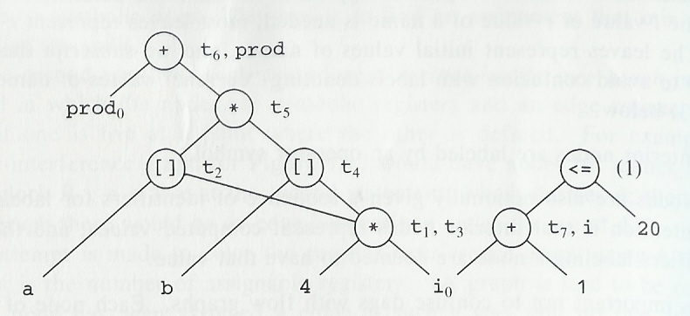
Dag Example

Slide 47
Using Dags
A dag can be automatically constructed from code using a simple algorithm
Several useful pieces of information can be obtained:
  Common subexpressions
  Which identifiers have their values used in the block
  Which statements compute values that could be used outside the block
Can be used to reconstruct a simplified list of quadruples
  Can evaluate interior nodes of dag in any order that is a topological sort (all children before parent)
  Heuristics exist to find good orders
  If dag is a tree, a simple algorithm exists to give optimal order (order leading to shortest instruction sequence)

Slide 48
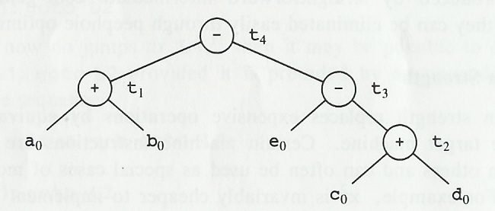
Generating Code from Dags (1)
t₁ := a + b
t₂ := c + d
t₃ := e – t₂
t₄ := t₁ – t₃
t₂ := c + d
t₃ := e – t₂
t₁ := a + b
t₄ := t₁ – t₃

Slide 49
Generating Code from Dags (2)
Assume only t₄ is live on exit of previous example and two registers (R0 and R1) exist
Code generation algorithm discussed earlier leads to following solutions (second saves two instructions)
MOV a, R0
ADD b, R0
MOV c, R1
ADD d, R1
MOV R0, t₁
MOV e, R0
SUB R1, R0
MOV t₁, R1
SUB R0, R1
MOV R1, t₄
MOV c, R0
ADD d, R0
MOV e, R1
SUB R0, R1
MOV a, R0
ADD b, R0
SUB R1, R0
MOV R0, t₄

Slide 50
Optimal Ordering for Trees
l_{a} > l_{b}
  evaluate a (leave result in a register)
  evaluate b using l_{b} registers
  ⇒ evaluation of t requires l_{a} registers
t
l_{a} = l_{b} = l
  evaluate a (leave result in a register)
  evaluate b using l registers
  ⇒ evaluation of t requires l+1 registers
a
b
l_{a}
l_{b}
(here, optimal means using the fewest number of registers with no stores of interdmediate results)

Slide 51
Labeling Algorithm
t₄
2
t₁
t₃
2
1
a
b
e
t₂
1
0
1
1
c
d
1 for left leaves
0 for right leaves
max(l_{a},l_{b}) for interior nodes where l_{a} ≠ l_{b}
l+1 for interior nodes where l_{a} = l_{b} = l
1
0

Slide 52
Code Generation by Tree Rewriting (1)
choosing instructions is a large combinatorial task
Fig. 9.31
  a tree rewriting technique to generate code automatically
  assume that it is more efficient to use a single instruction to compute a larger subtree

Slide 53
Code Generation by Tree Rewriting (2)
:=
ind
+
+
mem_{b}
const₁
+
ind
Intermediate Code
tree for a[i]:= b + 1
const_{a}
reg_{SP}
+
const_{i}
reg_{SP}

Slide 54
Code Generation by Tree Rewriting (3)
:=
ind
+
Generated Code
MOV #a,R0
+
mem_{b}
const₁
+
ind
reg₀
reg_{SP}
+
const_{i}
reg_{SP}

Slide 55
Code Generation by Tree Rewriting (4)
:=
ind
+
Generated Code
MOV #a,R0
ADD SP,R0
+
mem_{b}
const₁
reg₀
ind
+
const_{i}
reg_{SP}

Slide 56
Code Generation by Tree Rewriting (5)
:=
ind
+
Generated Code
MOV #a,R0
ADD SP,R0
ADD i(SP),R0
reg₀
mem_{b}
const₁

Slide 57
Code Generation by Tree Rewriting (6)
:=
ind
+
Generated Code
MOV #a,R0
ADD SP,R0
ADD i(SP),R0
MOV #b,R1
reg₀
reg₁
const₁

Slide 58
Code Generation by Tree Rewriting (7)
:=
ind
reg₁
Generated Code
MOV #a,R0
ADD SP,R0
ADD i(SP),R0
MOV #b,R1
INC R1
reg₀

Slide 59
Code Generation by Tree Rewriting (8)
reg₁
Generated Code
MOV #a,R0
ADD SP,R0
ADD i(SP),R0
MOV #b,R1
INC R1
MOV R1,*R0

Slide 60
Code Generation by Tree Rewriting (9)
:=
ind
+
Generated Code
MOV #a,R0
ADD SP,R0
ADD i(SP),R0
MOV #b,R1
INC R1
MOV R1,*R0
+
mem_{b}
const₁
reg₁
+
ind
const_{a}
reg_{SP}
+
const_{i}
reg_{SP}

Slide 61
Summary
Code Generator
A Simple Code Generating Algorithm
Register Allocation in Basic Blocks
Global Register Allocation
Labeling Algorithm
Code Generation by Tree Rewriting

Slide 62
Code Generator (1)
source
program
front
end
intermediate
code
optimizer
intermediate
code
code
generator
target
program

Slide 63
Code Generator (2)
must generate code that is correct and of high quality
  resources of target machine must be used efficiently (machine dependent optimizations)
    register allocation
    instruction selection
  machine independent optimizations are discussed in Chapter 10

Slide 64
A Simple Code Generating Algorithm
For each statement x:= y op z
Determine L, y’, z’
Generate MOV y’,L
Generate OP z’,L
Indicate that x is in L
L: location where result will be stored
y’: one of the current locations of y
z’: one of the current locations of z
Better if y’, z’ are registers rather than memory!
⇒ Which values should be kept in registers?

Slide 65
Basic Blocks and Flow Graphs
Flow Graph
  directed graph that represents the flow of control
MOV R1,R0
ADD c,R0
SUB R1,R2
MOV R0,R3
ADD f,R3
MOV R3,e
Basic Block
  node of a flow graph
  sequence of consecutive statements
  flow of control enters at the beginning and leaves at the end without possibility of branching except at the end
MOV R0,R3
SUB R2,R3
MOV R3,f
MOV R2,R1
ADD c,R1

Slide 66
Next-Use Information
“statement j uses the value of x computed at statement i”
  if j has x as an operand and control can flow from i to j without an assignment to x
…
x := y op z
…
…
a := b op x
…
i: x := y op z
…
j: a:= b op x
“x is live on exit from a block”
  if x may be used outside the block
  assume all non-temporary names are live on exit (to be conservative)

Slide 67
Instruction Costs
one, plus one for each memory address or literal in the instruction
  corresponds to the length of the instruction
  time to fetch an instruction exceeds time to execute it
examples
  MOV R0,R1 (cost 1)
  MOV R2,M (cost 2)

Slide 68
Register Allocation in Basic Blocks (1)
Simple Strategy
  Leave computed results in registers as long as possible
    ie, until the register is needed for another computation
  Store all registers at the end of a basic block
    for simplicity’s sake
    ways to keep registers across block boundaries to be discussed later
Should L be assigned a register or memory?

Slide 69
Register Allocation in Basic Blocks (2)
  1. use y if it is in a register, holds the value of no other names, is not live, and has not next use
  2. use an empty register if there is one
  3. use an occupied register if op requires that x be in a register or x has a next use (store the original value of the register in memory)
  4. use the memory location of x if x has no next use or no suitable register is found

Slide 70
Global Register Allocation (1)
Keep registers across block boundaries
  Saves stores at the ends of blocks
  Saves loads at the beginnings of blocks
How?
  Programs spend most of their time in loops
  Assign some fixed number of registers to values used frequently throughout a loop

Slide 71
Global Register Allocation (2)
  one for each use of x that is not preceded by an assignment to x in the same block
    once assigned to a register, good chance x will remain there throughout the block
Savings
  two for each block where x is assigned a value and is live on exit
    store at end of block, load at beginning of block

